Slide 1
Kentucky’s First ABM
Andrew Rohne
KY Model User Group
November 16, 2017

Slide 2
Background - Location
90 minute drive

Slide 3
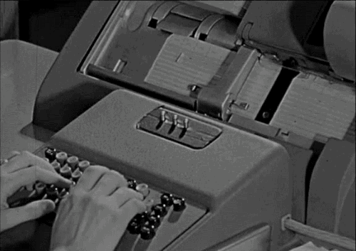
Background – Model History
First model in 1968 - First plan in 1971
Mid/late 90s: North South Corridor
2012 – now: Finishing New ABM

Slide 4
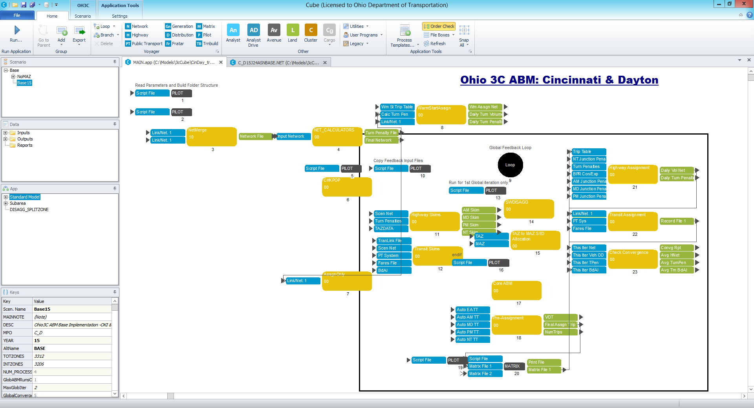
Background - Interface

Slide 5
ABM Development
CT-RAMP 4
Coordinated Travel – Regional Activity Modeling Platform
ODOT-led project with contributions from MPOs
OKI, MVRPC (Dayton)
MORPC, LCATS (Columbus, Newark)
NOACA (Cleveland) + maybe AMATS (Akron)
Started in 2013, currently mostly complete

Slide 6
Development Data
Merged datasets where possible
OKI 2010 HHTS (poor quality- imputed mode/purpose)*
MVRPC and MORPC mid-90s surveys
NOACA 2012 HHTS (partially modeled/imputed)*
* = Important reference: my TRB Applications Conference Presentation in 2014

Slide 7
From the Simple To The Complex

Slide 8
Simple to Complex
Trip Model: 4 (ish) steps
Special CVG Airport model, simple truck model
4 - 7 hour runtime (8 core Xeon w/36 GB RAM)
ABM with many steps
Long Term Choices
Short Term Choices
Any More Choices? Many More Choices!
20-30 hour runtime (2x12 core + HT w/768 GB RAM)

Slide 9
ABM Choices
Long Term Choices
Short Term Choices
Usual Workplace Location
Usual School Location
Mobility
Free Parking
Auto Ownership
Bicycle Ownership
Toll Transponders
Destination, Mode, Time
Stops
Escorting

Slide 10
ABM Features
Synthetic Population
Synthetic Households
Household Interactions
Specific Travel Patterns (disaggregate trip list)
The WHO, WHERE, WHY, AND WHEN of ALL household trips!

Slide 11
Model Status

Slide 12
…with caveats
Trip Model Won’t Die Yet
Many input data formats the same
Python scripts to handle conversions
Tentatively using ABM for Next Plan Update
Spring 2019 Model Validation Goal
(It sounds further away than it actually is)
Notes:
The Spring 2019 goal sounds long until you realize that there is only enough time for 3 model runs per week without major schedule adjustments!

Slide 13
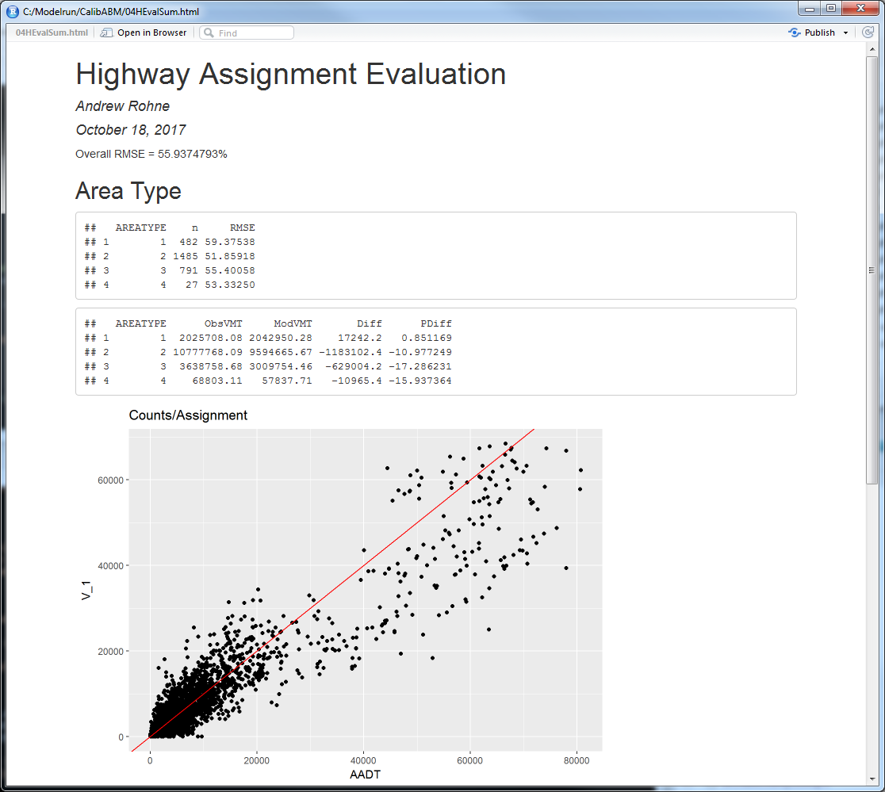
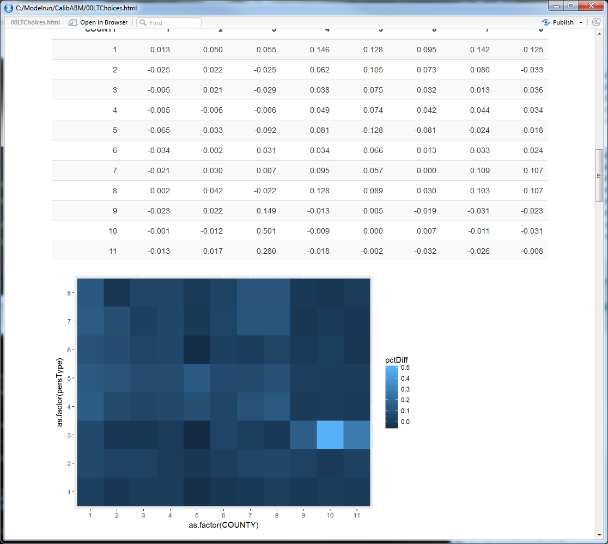
Status
Working on 2015 Run - Challenging
Survey base was of poor quality and too old
40 years of reports that need adapting
Using a lot of R/R-Studio/R-Markdown
New Issues
Bugs with WSP’s Java Software
Moved Cheese
Input File Bugs

Slide 14
Data Considerations - Need lots of data
5,000 HH ‘uncontrolled’ survey recommended
Per Peter Vovsha, ABJ40 Meeting, TRBAM 2015
Household completeness
Work vs. Work-related (or school)
Transit survey data
Notes:
ABMs need tons of data.

Slide 15
Data Considerations – Need Lots of Data
University Data for Major Universities
U. Cincinnati, Miami U., and Northern Kentucky U.
Students living on, off, and way off campus
Establishment survey data, potentially becoming more important

Slide 16
Is It Better?

Slide 17
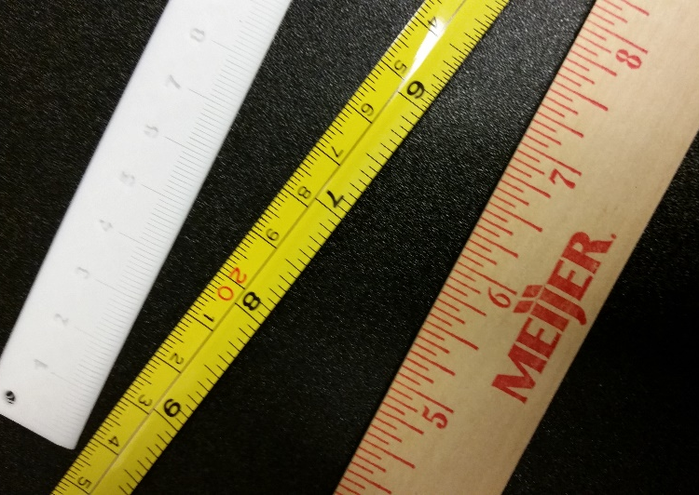
Is It Better – Calibration?
Fallacious Argument!
2010 and 2015 trip and ABM have a similar RMSE
Work undertaken until RMSE is acceptable
Easier? Maybe for ABM experts!
Garbage In, Garbage Out!
Notes:
Trying to decide if a model is better by calibration standards is like trying to say a ruler is better than a tape measure! The models are basically two of the same, one nicer and more complex but very difficult to compare.

Slide 18
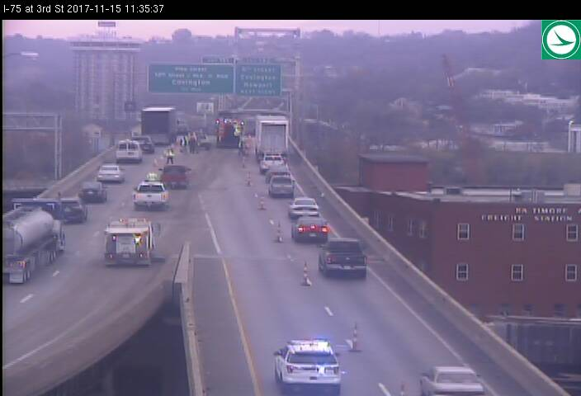
Is It Better – Features?
Cost items (tolling)?
Remains to be seen
Lack of data to compare
Last Round of BSB Toll Volume Forecasts…
Included VoT and income
Modeled with Trip Model

Slide 19
Is It Better - Features

Slide 20
Is It Better - Features
Can we model EJ Households?
Can we model IMPACTS to EJ Households?

Slide 21
Is It Better - Software
Nope.
Little Useful Documentation*
Source will take some ‘getting used to’
(and might require an expert)
Notes:
Part of the ‘little useful documentation’ is because we’ve had 50+/- years of trip model documentation and widespread experience vs. 10-15 years of ABM documentation and sparse experience.

Slide 22
Moving Forward

Slide 23
Moving Forward
Establishment Survey in-hand
Freight Data In-hand
HHTS?
TOBS?

Slide 24
Moving Forward
Usable Documentation
Blogs? Answers.tfresource.org?
Increased ad-hoc groups to discuss issues
TMIP Webinars, Documents?
More from Zephyr Foundation?
Howto Videos? Blogs? Standards? Methods?

Slide 25
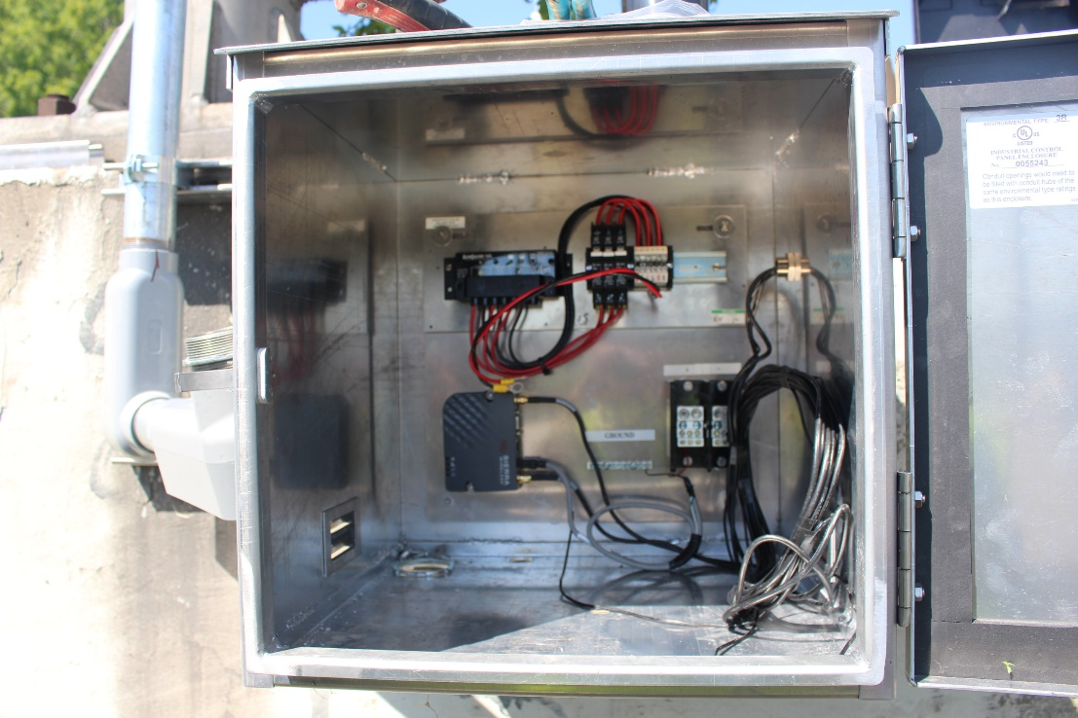
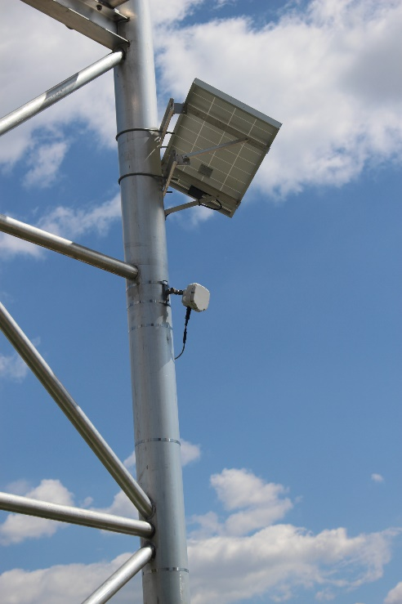
Moving Forward
Better Data Collection
Increased QA/QC Procedures on traffic counts
Ohio River Bridge Counts (24x7x365 on 5/7 bridges)

Slide 26
Lessons Learned

Slide 27
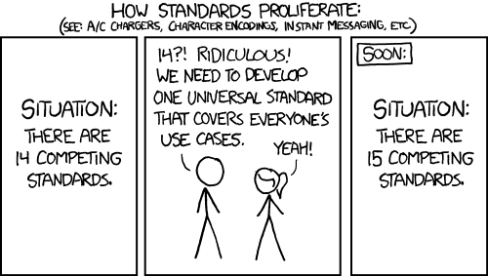
Project Management
Data Standards ROCK!
(As long as you don’t change them often)
(And as long as you enforce them)

Slide 28
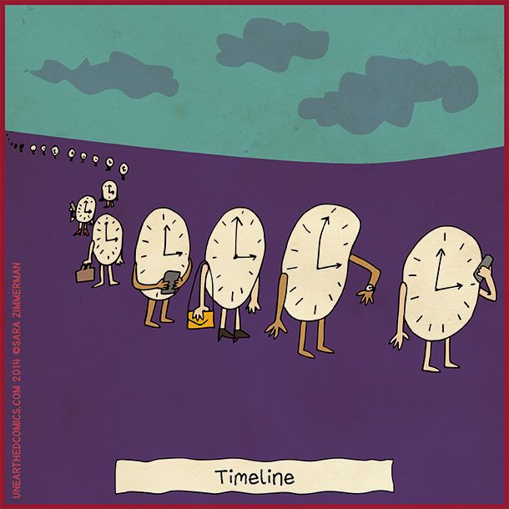
Project Management
Take your original timeline, multiply it by 3

Slide 29
Project Management
Working in Groups Helps
All MPOs looking at their model, but finding issues that get fixed in all models

Slide 30
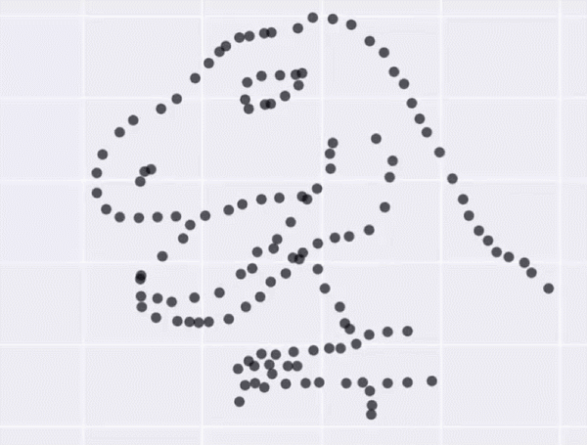
Data, data, data
Descriptive Statistics Help
Visualization is Critical!
(develop BEFORE starting)

Slide 31
Things to Research

Slide 32
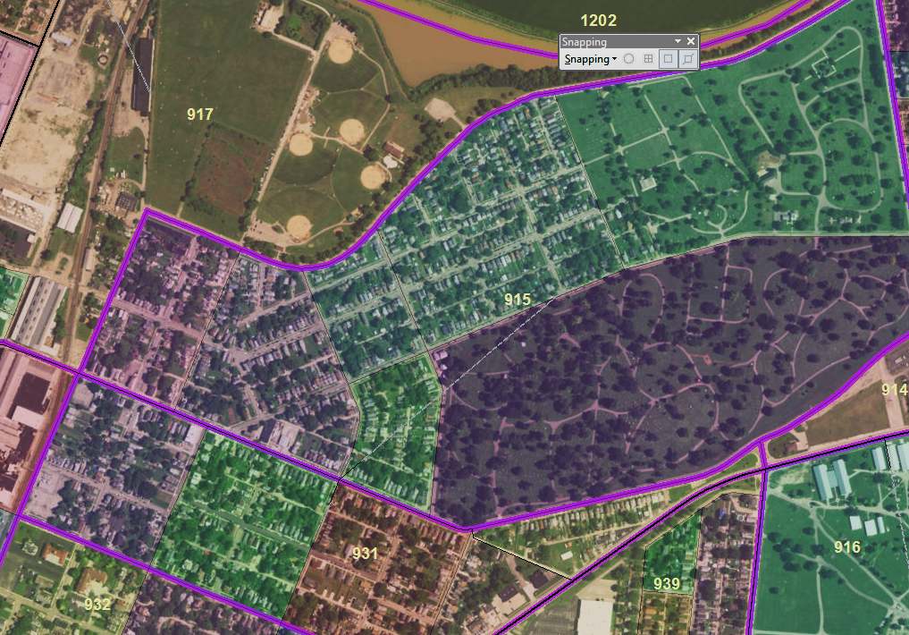
To MAZ or Not To MAZ
(that is the question)

Slide 33
Sensitivity and Elasticity
Major Improvements?
Major Destruction?
The Airport?
TMIP Comparisons!

Slide 34
The Future?
What happens when we click ‘run’ on 2040?
Sensitivity and elasticity in 2040?
Change in basic measurements 2015-2040?

Slide 35
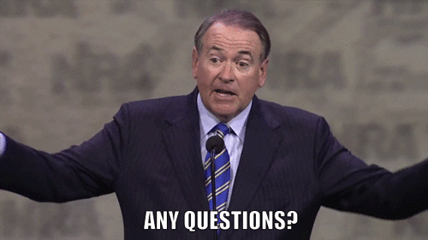
Andrew Rohne
arohne@oki.org
@okiAndrew

